Slide 1
Extragalactic Astrophysics and Cosmology Group Study 2013
Predictions Group

Slide 2
Our Aim:
To be able to predict the number of high redshift galaxies one would detect within a given absolute magnitude range for a given filter band.

Slide 3


How we intend to do this:
Find a general Schechter Function.
Mathematical process to convert Schechter Function into observing units.
Build program to automate process. IN PROCESS
Find plausible starting parameters.
Collate parameter data from papers. IN PROCESS
Determine parameter evolution with time. IN PROCESS
Plot results/ data visualisation.
Give to observers.
Refine technique- include more sophisticated adaptations.

Slide 4

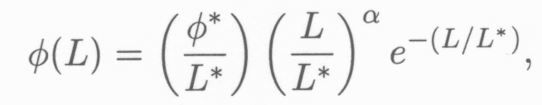

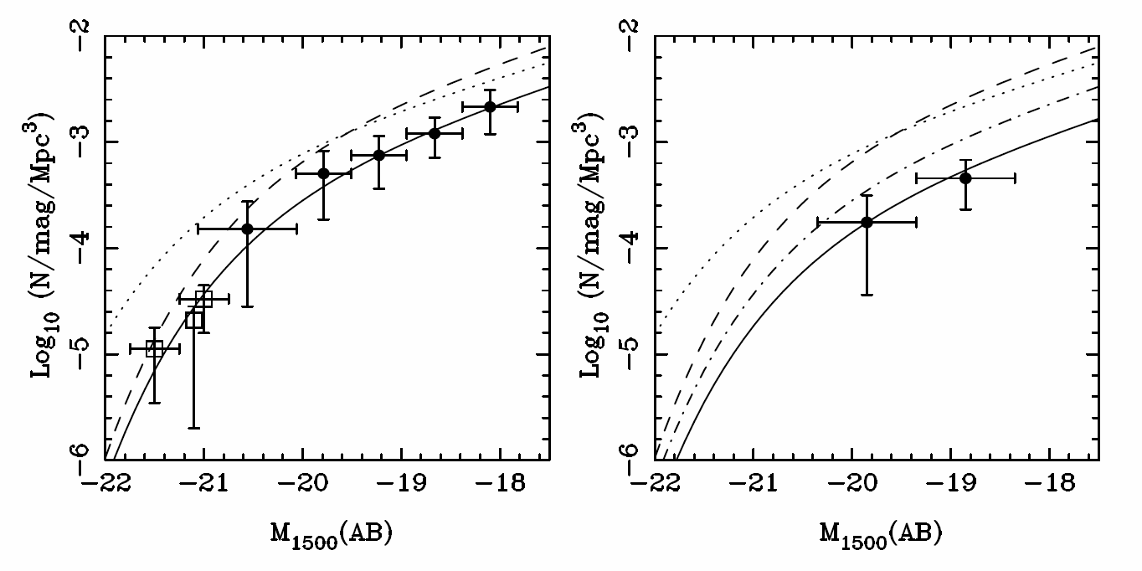
Schechter Function
Z=7
Z=8
(McLure, 2010)

Slide 5

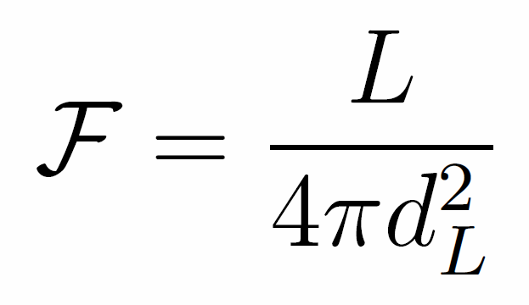
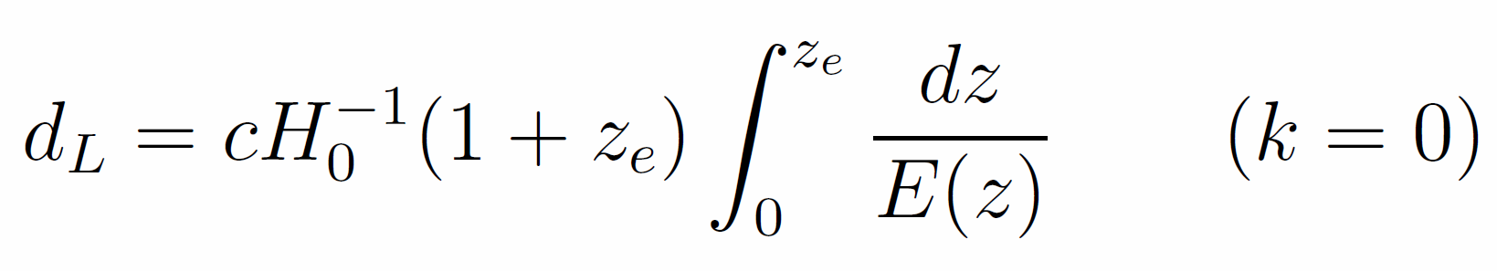
Co-moving Distance
Luminosity Distance
Magnitude Conversion
Notes:
dH (hubble distance) radius of the visible universe. Luminosity distance is redshifted. Magnitude conversion is for AB system.

Slide 6
Assumptions
Universe is:
Flat
Matter Dominated
No cosmic variance
Constant Schechter Function
Parameters of the Schechter function do not change as a function of redshift.

Slide 7
Schechter Function
Next step is to add variation in the parameters of the Schechter Equation as a function of redshift.
Involve using real data from observations
Extrapolate backwards for higher redshift
Try different fits for data.

Slide 8
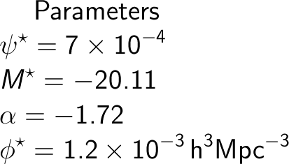
Parameters
Parameters taken from papers on high redshift galaxies.

Slide 9
Programs A. And B.
We have two programs computing the same quantities in slightly different ways in order to validate any results we obtain.
Owen and Andy

Slide 10
How we could refine this
LEWIS

Slide 11
Plans for the future:
Get both programs working.
Continue trying to gather relationship of parameters with time.
Research into cosmic variance; how are we going to include it in our calculations? What formulae might we need?
Produce refined programs.
Meanwhile all continually working on our own individual contributions to the report which were designated last Tuesday.

